Slide 1
Welcome to Year 7 at St Joseph’s
New intake Parents’ information evening

Slide 2
Welcome Mr Woods
Transition Miss Unsworth-Hughes
Behaviour, Safety & Welfare Mr Singleton
Travel & Transport Mr Graham
The Year Ahead Mrs Horridge
Your Questions Answered Mr Woods
PSA Mrs Jowett
Meet the Form Tutor Year 7 Form Tutors

Slide 3
Mission Statement
“Our school is a community where Jesus Christ is our role model and his message the guiding principle behind all we do. Every member of our community is responsible for creating an environment that is caring, fair and respectful of each individual. We develop our potential, celebrate our talents and go forward together in faith.”

Slide 4
Miss Unsworth-Hughes

Slide 5
Behaviour, Safety and Welfare
Mr Singleton

Slide 6
Travel and Transport
Mr Graham

Slide 7
Manager of
Mrs Horridge

Slide 8
Overall, my role is to remove any obstacles in the way of your child’s progress…
Notes:
Whether that be problems in learning, behaviour or issues with settling in friends etc.

Slide 9
Manager of Learning
Ensure ALL pupils are the best that they can be
Monitor transition process
Track your child’s academic progress
Support your child’s health and wellbeing
Act as a contact for you in school
MoLHH@st-josephs.bolton.sch.uk

Slide 10
Key Information

Slide 11
Key Dates
Wednesday 7th September Term Begins 8.45am
Thursday 8th September Year 7 Photographs
Tuesday 20th September Year 7 Welcome Day & Mass (7pm)
Tuesday 18th October Residential
Tuesday 15th November Year 7 Parents’ Evening

Slide 12
Key People
Form Tutors
Pupil Progress Coordinator
Nurture support Mrs Philpott
School counsellor Mr Charnley
Assistant Head Pastoral Mr Singleton
Deputy Head, (Behaviour) Mr Graham
Deputy Head, (Teaching & Learning) Mrs Morgan
Head Teacher Mr Woods
Heads of Departments
Notes:
I don’t do it all on my own!

Slide 13
The School
Nurture your child’s spiritual development and formation
Care for your child’s safety and well being
Promote high standards of work and behaviour and provide clear guidance for students and parents
Ensure your child is given every opportunity to achieve their full potential as a valued member of the school community
Provide a balanced curriculum to meet your child’s individual needs
Contact you if we have any concerns and keep you informed about your child’s progress and how you can help them at home
Set, mark and monitor homework
Keep parents informed about school activities

Slide 14
Formation
Formation of young Catholic Christians with a sense of responsibility for their community and their world

Slide 15
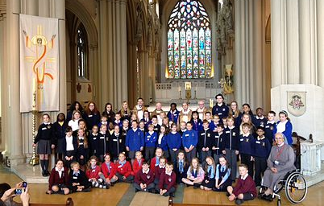
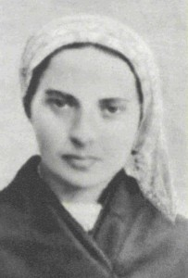
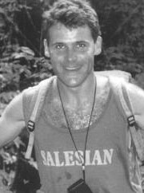
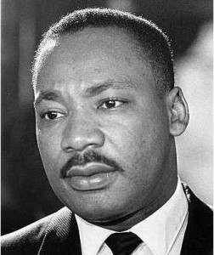
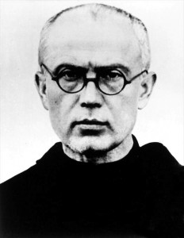
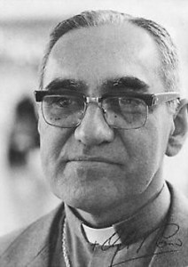
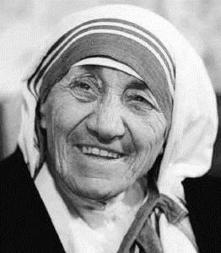
Formation

Slide 16
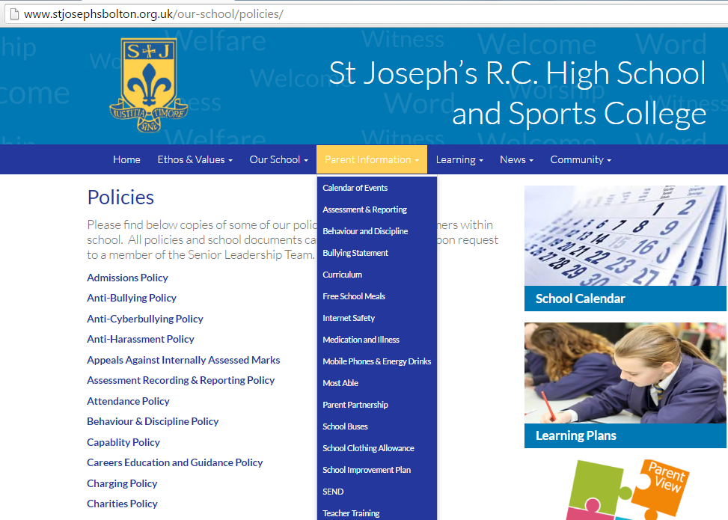
Safety and Wellbeing

Slide 17
Reward System
Motivate students by recognising all their achievements
Celebrate the successes of all students
Points Based
Chosen and Awarded by Staff.
Certificates can be automatically generated

Slide 18
Curriculum

Slide 19
Homework

Slide 20
School Activities
Use the school website for regularly updated information on school activities such as:
Religious Retreats
Sports Visit to Italy
Ski Course 2017
Fairtrade
Enrichment 2015-16
PE Enrichment Timetable Summer 2016

Slide 21
The Parent/Carer
See that my child takes a full and active part in the spiritual life of St Joseph’s
See that my child goes to school regularly, on time, properly dressed and properly equipped
Make the school aware of any concerns or problems that might affect my child’s behaviour
Support my child with his/her homework and home learning opportunities and ensure my child completes homework on time
Attend parents’ evenings and discussions about my child’s progress
Support the school with any disciplinary sanctions
Support my child in responding positively to the general expectations and regulations of the school
Monitor my child’s internet usage to comply with e-safety regulations
Support school with the mobile phone policy

Slide 22
Attendance
Excellent attendance is 97+% attendance
95% attendance is 3 months of school missed
If your child is ill
Please contact the office before 8.30am to report their absence
Please contact school on every day that your child is absent / provide a note to your child’s form tutor on their return
In school, your child must see Mrs Horridge to be sent home
If your child has a medical appointment and needs to be collected early, please ensure that they have a note in their planner for the form tutor
Medication must be stored in the school office with relevant documentation: please ask for more information
Holidays in term time are only authorised in EXCEPTIONAL circumstances and must be applied for in advance

Slide 23
Equipment
Please ensure your child has the correct equipment for the day ahead
Encourage them to pack their bag on the night before
Use their planner to support them
Ensure they have enough lunch money
Please send them with a coat especially in inclement weather

Slide 24
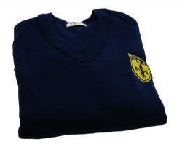
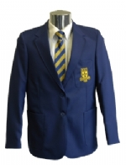
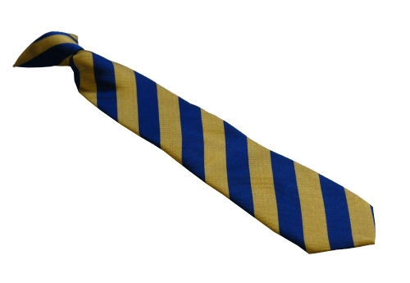
Uniform
Item | Description | Notes and Exclusions
Blazer | St Joseph’s school blazer with motif | To be worn at all times in the school building, staff permission to remove in lessons
Tie | St Joseph’s tie | To be worn at all times
Jumper | St Joseph’s school jumper with motif | Optional to be worn underneath the school blazer
Shirt | White school shirt

Slide 25
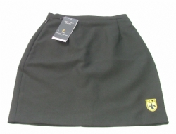
Uniform
Item | Description | Notes and Exclusions
Skirt | Badged Black skirt of knee length | No other skirt is acceptable
Trousers | Black plain formal school trousers with a crease (can be worn by girls also) | Not permitted: ‘Skinny’ trousers Jeans of any description Fashion trousers of any description Low slung trousers

Slide 26
Uniform
Item | Description | Notes and Exclusions
Coats | Coats must be black, blue or grey in colour | Not permitted: Hoodies, Track suit or drill suit tops; Leather or denim coats or jackets; Combat jackets;
Shoes | Plain black shoes are to be worn | No fabric footwear allowed The following are NOT acceptable: • Sporting logos & sporting motifs • Trainers or boots • Fashion footwear (e.g. Vans / Converse) • Any other fabric footwear

Slide 27
Uniform
Item | Description | Notes and Exclusions
Bags | Bags used for school purpose must be practical and not fashion bags Yes… • Sturdy to carry books, equipment and pupil planner without items bending or getting into a poor condition. Be able to fit an A4 file into it. • Minimal decoration | No… • No handbags / fashion bags • No plastic carrier bags • No drawstring sports type bags (can be used for P.E. kits but not as a school bag) • No chains (Health & Safety reasons)

Slide 28
Uniform
Item | Description | Notes and Exclusions
Hair styles | Must be conventional and smart Hair longer than shoulder length must be tied back with discrete bobbles | No shaved or part shaved styles of hair Excessive ‘volume’ or ‘differential’ styles are not permitted Hair gel or colouring is not allowed Hair extensions are not allowed Boys must be clean shaven
NOT ALLOWED | Make-up, fake tan or hair dye. Jewellery of any kind other than a wristwatch False nails or nail polish.

Slide 29
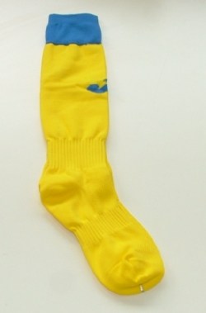
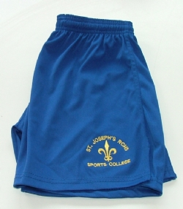
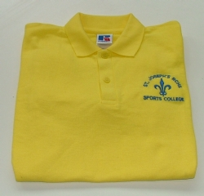
PE Kit
Boys | Girls
Yellow Football Shirt | Yellow Polo Shirt
Royal Blue Shorts | Royal Blue Shorts
Yellow Socks | Yellow Socks
Optional Waterproof | Optional Zip-thru performance top
Optional Royal Blue Football Shirt | Optional Waterproof
Training Shoes, Football Boots, Shin Pads, White socks. | Training Shoes, White socks, Shin pads.

Slide 30
Purchasing Uniform
The distinctive elements of the uniform and PE kit are obtainable from three different suppliers:
Contract Schoolwear by Mr Lucas (01204) 62464
Andrew Leach’s Sports and Schoolwear in Horwich (01204) 697624
Whittakers Schoolwear in association with Parkers in Bolton (01204) 389485
All details on the school website
Order forms for PE kit are in your parent packs: return by Wed 20th July

Slide 31
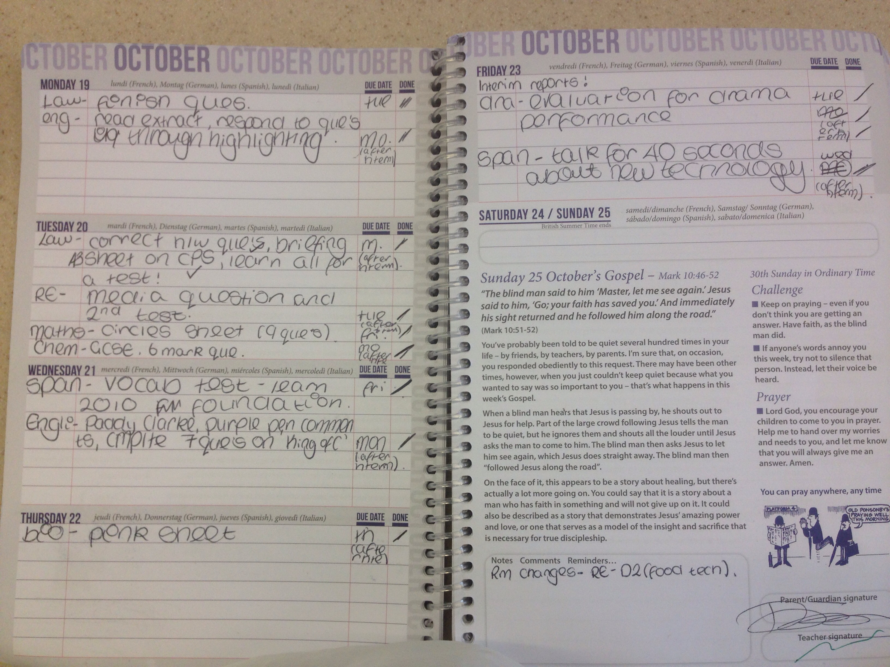
Homework
Your should use this to monitor your child’s homework
You MUST sign your child’s diary EVERY WEEK.
This is also a key method of communication between school and home

Slide 32
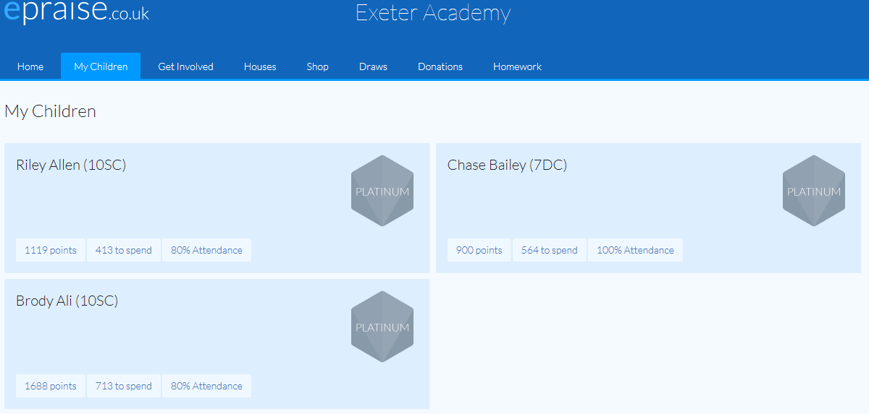
Reward System

Slide 33
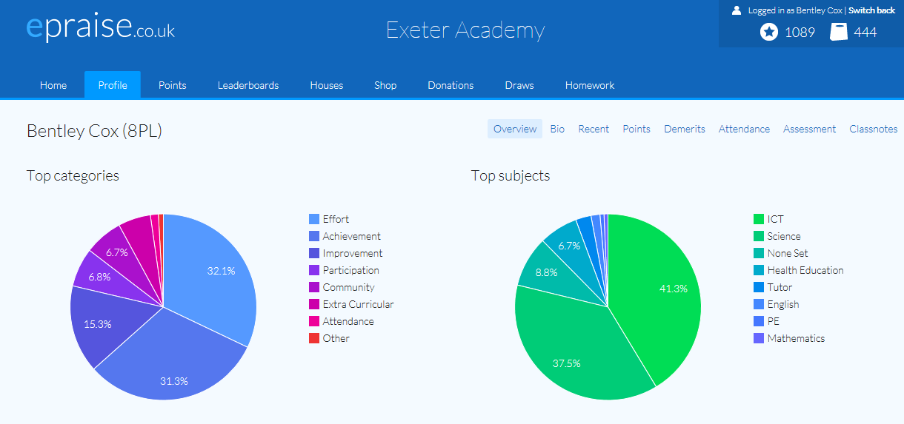
Reward System

Slide 34
Expectations
Mobile Phones
Drinks
Mobile phones should not be turned on in school
Pupils may hand them to the school office in the day
Phones seen in school will be confiscated to be collected by parent/carer
Water bottles should be kept in bags at all times
Energy drinks are not permitted in school
Please ensure that your child does not bring energy drinks for refreshment

Slide 35
The Student
Take a full and active part in the life of St Joseph’s as a Catholic School
Attend school regularly and on time with any necessary equipment
Wear school uniform and be tidy in appearance
Do all my classwork and homework on time and to the best of my ability
Tell a member of staff if I have any worries or concerns
Behave in a manner which is respectful to people and property both inside and outside school
Observe school’s rules and expectations
Follow the school rules with e-safety and mobile phones

Slide 36
Residential – 18th October

Slide 37
A “typical” day
08.45 | Warning Bell | Pupils line up on yard with Form Tutor
08.50 – 09.15 | Registration | Pupils spend time in form with Form Tutor
09.15 – 10.05 | Lesson 1
10.05 – 10.55 | Lesson 2
10.55 – 11.10 | Break | Pupils can buy snacks from the canteen
11.10 – 11.15 | Bell | Movement Bell for Lesson 3
11.15 – 12.05 | Lesson 3
12.05 – 12.55 | Lesson 4
12.55 – 1.45 | Lunch | Pupils will eat in the school hall
1.45 – 1.50 | Bell | Movement Bell for Lesson 5
1.50 – 2.40 | Lesson 5
2.40 – 3.30 | Lesson 6

Slide 38
Registration / Form Tutor
Pupils have already met their form and form tutor
We encourage new friendships in forms
Daily activities to support and develop your child
On the first day:
Planner
Timetable of subjects
Tour of school
Lunch money system

Slide 39
Break time and Lunchtime
Dinner Money system
Allergies
Daily limit
Extra-curricular activities timetable
“Early” lunch in first week

Slide 40
End of the Day
Extra-curricular activities
Buses: school website

Slide 41
Your Questions Answered
Mr Woods

Slide 42
Meet the Form Tutor

