Slide 1
My book of changes
Thinking about changes that are coming up

Slide 2
About this book
This activity book will help you think about the changes that are happening at the minute (being away from school).
This book will help you to reflect about now and the future. It will let you explore your thoughts and feelings around change.
Remember: the aim of this book is to help, you do not have to do it and you do not have to do all if you choose not to.

Slide 3
Rules about this book
This is book belongs to ____________________ (me)
I can choose who sees my book
I can get people to help me with my book
I can write or draw my ideas in this book – I can change things if I want
I will keep my book safe

Slide 4
About me: These are a few of my favourite things
At the time of covid-19, we are off school. These are things that are important to me (write in the boxes)…
A hobby
Favourite meal
Best friends/ people I care about
An item that makes me fee safe and happy
Something I’m good at
Games I like to play

Slide 5
Being off school
At the minute, being off school or returning to school is very different to how it was before.
Some people find this fun, others find it difficult.
Sometimes, it can be hard not knowing the future.
This can makes us feel unsettled, anxious, worried or nervous – it may not
Circle words that describe what you think and feel
Worried | Excited | Strange | Confused | Fun
Happy | Weird | Fearful | Lonely | Over joyed
Nervous | Anxious | Unsettled | Angry | Fed up
Overwhelmed | Free | Lost | Together | bored

Slide 6
Being off school - What it means to me -
What does/did being off school mean to me?
Write a sentence about what being away from school and friends means to you.
………………………………………………………………………………………………………………
………………………………………………………………………………………………………………
………………………………………………………………………………………………………………

Slide 7
My thoughts & feelings
3 things I think about being away from friends
3 things I feel about being away from friends
Space to draw myself

Slide 8
Think about things you liked to do before and during lock down
What I enjoyed
doing
What I like doing now
Things I am looking forward
Things I miss doing

Slide 9
How I might feel in times of change?
During change, we do not always know what will happen
This can make us, or people around us, feel worried. This may be seen as anger, sadness or being irritated. It can also make us feel excited and full of energy
It is normal to feel these things. It is ok that we don’t know what is going to happen
It is important that you and people you care about stay safe.

Slide 10
List things that you think about and worry you…
Today
Tomorrow
Next week
Next month
In a year

Slide 11
Thinking time
Did your worries get more or less from ‘Today’ to ‘Next Year’?
When do worries feel better?
Who can help with your worries?
Are there any things you do to have fun that make worries seem smaller?

Slide 12
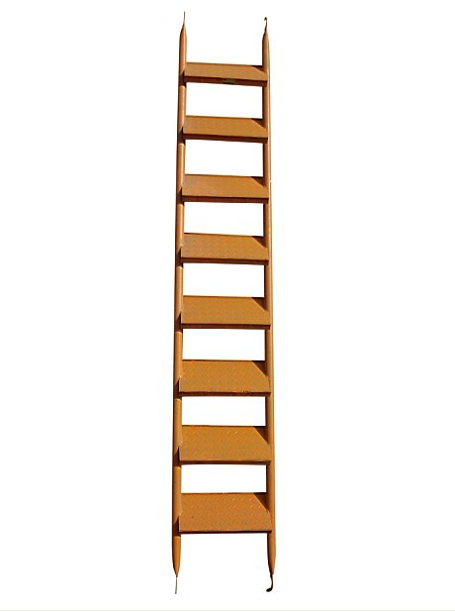
The worry ladder
Some thing really terrible happens
If you have worries, write them on scraps of paper. (1 worry per piece)
Place the worries the ladder (left) and think about how ‘big’ they are
The top of the ladder are our biggest worries, things we think about a lot or make us feel sad
The bottom of the ladder is for worries that are small. We may think about them, but they don’t really bother us
The higher up the ladder, the more worried we may be
I think about this a lot
I think about this sometimes, it isn’t a big problem
Something I think, but doesn’t upset me

Slide 13
Feeling better about our worries Sometimes, talking to people or being with people can make our worries feel much better.
Draw fun things you do, or people you to be with, that help your worries to feel better.

Slide 14
Moving on
At the minute, no body knows what will happen
This can be frustrating and confusing for us
Other children will feel the same way
Soon, things will start to change, and be similar to the way they were, though things might be different.
Look on the next page to see what might happen…

Slide 15
Moving on: When and How?
Some friends may not be in on the day I am in if they are in a different year group.
We may have another lock down
We may go back and not all year groups are in school
Some teachers and pupils may still be off
The school day may change
We may go back and see different teachers or staff
BUT… WE DON’T ACTUALLY KNOW YET!!!!

Slide 16
Same or Different
Challenge:
How many did you think of?
0-5 – Cool
5-8 Amazing
8-12 Wow!!!
12+ Incredible!
Thinking ahead to when we are back .
Make a list of things that will be the same and different
Same
Different

Slide 17
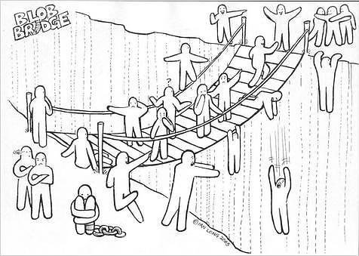
Look at this picture… imagine it is the journey from your current year group, to your new one. The different people in the picture show different feelings.
You may feel ‘mixed’ about the changes ahead.
Can you identity yourself (and colour in) as:
Someone on the bridge?
Someone who has either crossed or not?
Someone you’d get help from
Someone who looks like they need help

Slide 18
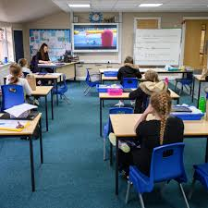
5…4…3…2…1
Take a moment to think about:
5 things you’re good at/ enjoy in school
4 things you’re good at out of school
3 things that have been successes for you
2 things you find tricky in school
1 thing you want to improve next year
Jot them in the boxes below
5
4
3
2
1

Slide 19
People and things I miss/ look forward to
In the space below: draw pictures or people and things that you miss about this year.
For every picture, draw something that you’re looking forward to.

Slide 20
My hopes and dreams
On the next few pages there are pages to think about and respond to
You will need to think about things that will happen in your future
These may be near to now, or far away
They should be important to you.

Slide 21
Somewhere I would like to go…

Slide 22
Something I would like to learn…

Slide 23
Something I would like to be able to do…

Slide 24
Something I would like to see happen…

Slide 25
My ‘animal me’
When faced with tricky, different and unusual times we need resilience
Resilience is like an inner strength, like a magic power in our bodies
In this section you will need to think about an animal you are like
What qualities does the animal have that make it strong / happy / able to cope?
e.g. Dog = fast, loyal, caring, playful, strong, friendly, clever…

Slide 26
My animal me: draw your ‘animal you’ and label the characteristics that make it special

Slide 27
‘Acrostic Me’
Write your name down the page (left). E.g. If you’re called Peter, write;
P
e
t
e
r
For each letter of your name, write something about you that makes you special, amazing or different.
Plays guitar
Enthusiastic
Turn taker
sErious
fRiendly

Slide 28
☺ Keep going- we are all here for you #weareallinthistogether#☺
Remember, when things are tough…
Think about your ‘animal you’ and what makes you special – how can you use these ‘skills’ to help you and others?
Think about the things that you like doing that make you happy
Think about the people who can help – let them share your problem
Is your problem/ worry ‘big’ or ‘small’; where would it go on your ladder?

