Slide 1
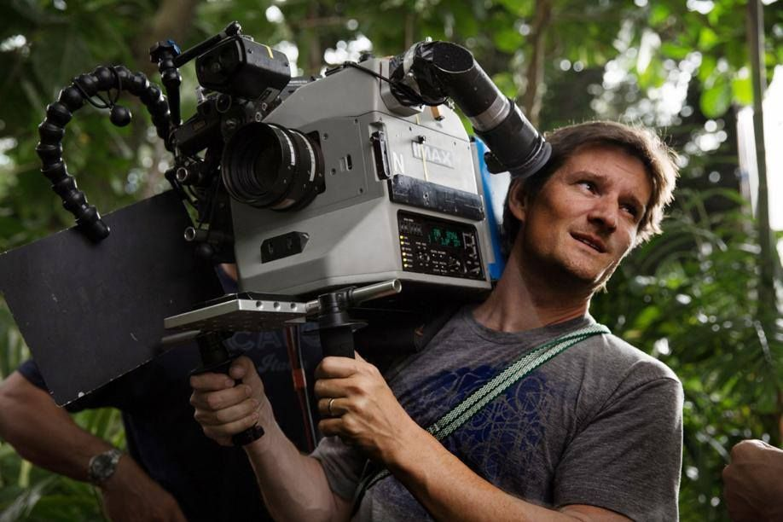
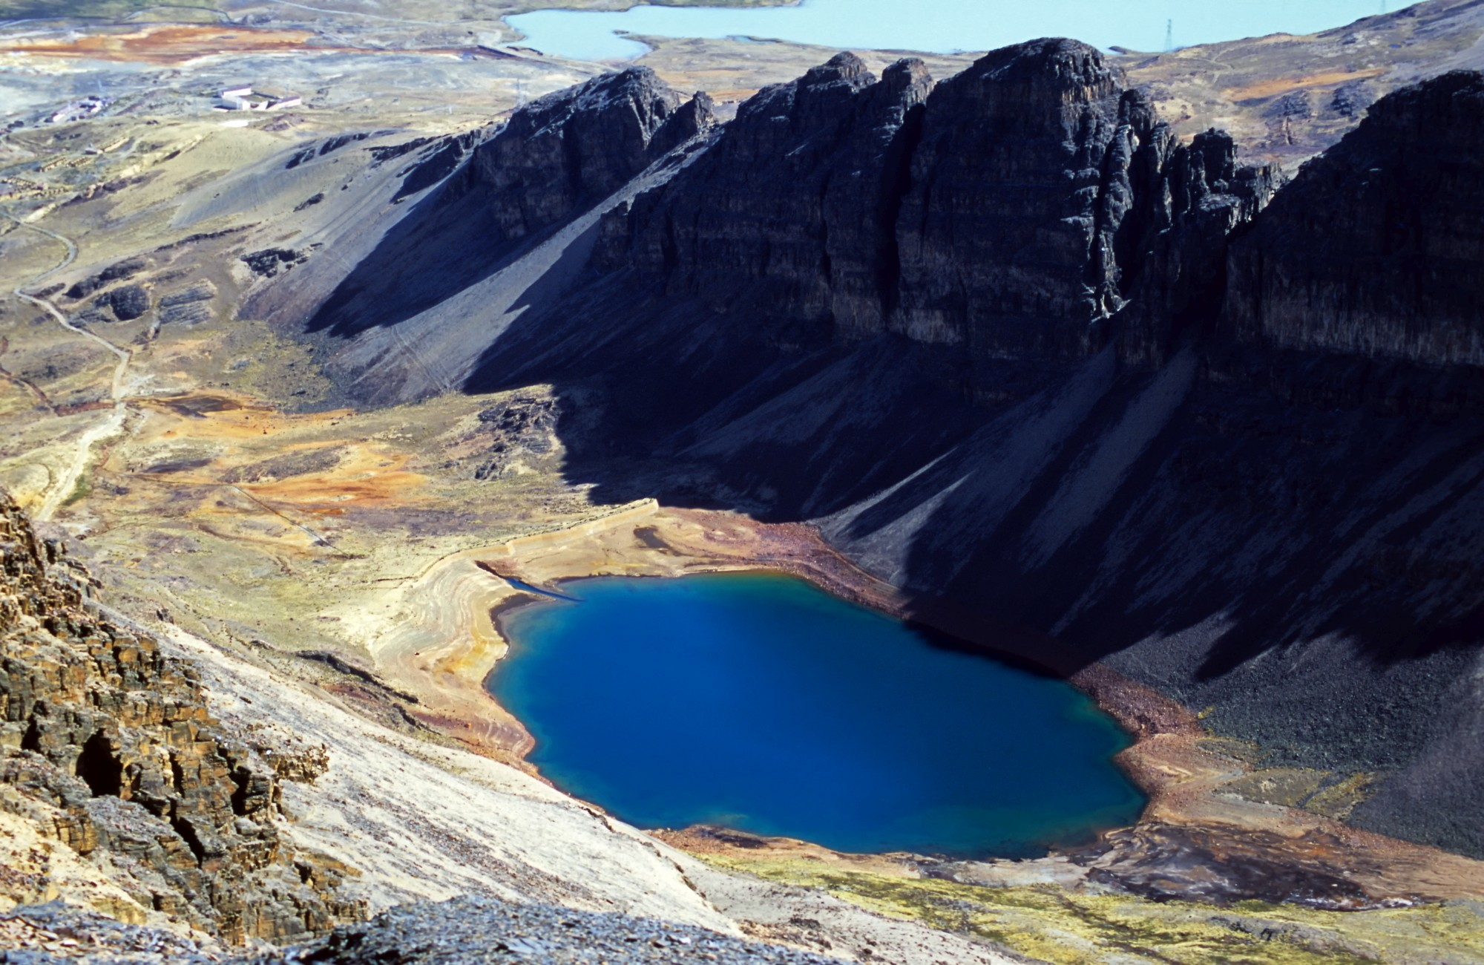
Root of the Week
Where does this root word come from?
Greek for ‘to write’
Use this space build a sentence using any of the ‘graph’ words provided.
graph
Geography
Cinematographer
Graphology
Examples
Can you think of anymore?
Link the image to the word

Slide 2
Definitions
Geography - The study and documentation of the physical features of the earth and its atmosphere. Of human activity as it affects and is affected by these, including the distribution of populations and resources and political and economic activities.
Cinematographer - A person who oversees or directs photography and camerawork in film-making, especially one who operates the camera (the one who writes down all the directions)
Graphology - The study of handwriting, for example as used to infer a person's character.
Graph – in maths, is sometimes a visual documentation of statistics/percentages or other information

Slide 3
Define it:
Graph = Greek for ‘to write’
Geography – Mr Tate and Mr Armstrong are the best Geography teachers in Bolton.
Cinematographer – Tom Stem was the cinematographer on Hunger Games.
Graphology-Is a recognised study which is called upon by the police to identify what a person’s state of mind when they wrote a particular document, be it a blackmail letter, a poison pen letter or a suicide note.
Can you think of any ‘graph’ words you have learnt in school and which subject were they in?
Write them down with their definition.

